Slide 1
At Risk Students
EAD 856

Slide 2
Definition
The term “at-risk” is often used to describe students who have factors in their lives that can have a negative effect on their educational success.
The actual definition of “at-risk student” has not been categorically defined across settings.
The lack of common language when describing the “at-risk” learner is problematic, especially in the era of NCLB, high stakes testing, and teacher accountability.

Slide 3
The National Center for Educational Statistics
A student who is likely to fail at school.
Students who drop out of high school prior to graduating.
Students who fail to meet basic proficiency in key subjects, such as mathematics and reading.
There are several factors that the NCTS reviews when defining the at risk student. These factors include the following:
Basic demographic characteristics to include: sex, race/ethnicity/socio-economic status
Family and personal background characteristics
The amount of parental involvement in the student’s education
The student’s academic history
Student behavior factors
Teacher perceptions of the student
Characteristics of the student’s school

Slide 4
US Legal
At-risk students are students who are not experiencing success in school and are potential dropouts. Usually, they are low academic achievers who exhibit low self-esteem. Generally they are from low socioeconomic status families. At-risk students tend not to participate in school activities and have a minimal identification with the school. They have disciplinary and truancy problems that lead to credit problems. They exhibit impulsive behavior and their peer relationships are problematic. Family problems, drug addictions, pregnancies, and other problems prevent them from participating successfully in school. As they experience failure and fall behind their peers, school becomes a negative environment that reinforces their low self-esteem.

Slide 5
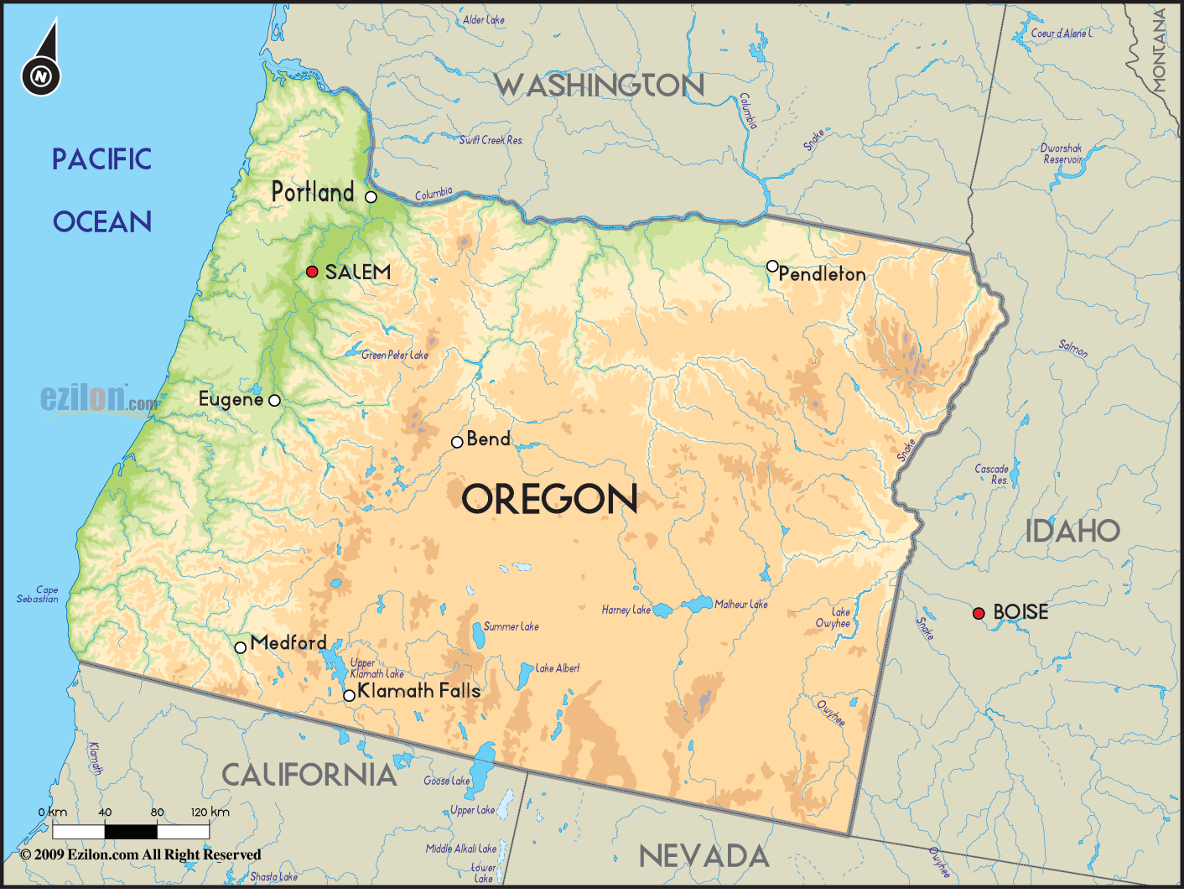
State of Oregon
A student who qualifies for a free or reduced lunch programs or
An at-risk student as defined by specific rules adopted by the school board if it has adopted rules to define an at-risk student.

Slide 6
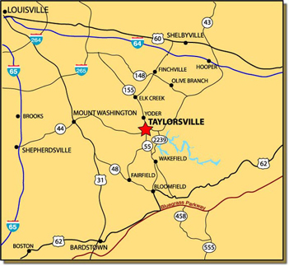
Spencer County Middle School-Spencer County Kentucky
School policy states that at-risk students are defined as having any of the following characteristics:
Excessive absenteeism and/or tardiness.
Low grades that do not reflect student’s potential.
Test scores indicating achievement below the current grade level.
Poor relations with peers as observed by school staff.
Multiple behavior referrals.
Parents or guardians unresponsive to phone calls, letters, or scheduled meetings.

Slide 7
National At-Risk Education Network-NAREN
Students are placed at-risk when they experience a significant mismatch between their circumstances and needs, and the capacity or willingness of the school to accept, accommodate, and respond to them in a manner that supports and enables their maximum social, emotional and intellectual growth and development.

Slide 8
What about Fayette County?
No set definition, but “at risk” is referred too often.
KDE Provides a tool that is called The Persistence to Graduation Tool
This tool is available as a part of Infinite Campus in our district.
Under KY State Reporting
Access is granted to administrators, counselors, and social workers at this time.
KDE also maintains a website that explains the PtG Tool….

Slide 10
This report may take several minutes to render. Please do not click Generate Report more than once. This tool identifies students who may be off-track to be promoted to the next grade level or graduate on-time. It is the responsibility of each school to determine necessary and appropriate supports and interventions for students who may be off-track for graduation. It is expected that using this tool will aid the district in increasing its graduation rate, as well as to fulfill the commitment to increase its college and career readiness rate. Using the indicators and rules listed below, the tool calculates a risk value for each student. Information is presented in descending order according to risk value, where students with larger risk values are at the top of the list. The tool generates two reports. The EXCEL file includes risk values and all prior academic and current academic year characteristics used to calculate the risk value, as well as additional supportive information that does not contribute to the risk value. The PDF file only includes risk value and point values for current year attendance, behavior, and performance. Due to the information captured in the two reports, it is recommended that schools generate the EXCEL report once per semester as a reference point. The PDF then can be generated throughout the academic year for more timely information. Risk values are calculated using the following rules for current academic year AND prior academic year data (* indicates current academic year only): Demographics: Student is LEP = 1 point* Student is 2 years older than expected for grade level = 1 point* Attendance: 5-10% classroom time missed current academic year = 1 point >10% classroom time missed current academic year = 2 points 5-10% classroom time missed prior academic year = 1 point >10% classroom time missed prior academic year = 2 points Behavior: 1-4 in-school removals (INSR) current academic year = 1 point 5+ INSRs current academic year = 2 points 1-4 INSRs prior academic year = 1 point 5+ INSRs prior academic year = 2 points 1-4 suspensions (SSP3) current academic year = 1 point* 5+ SSP3s current academic year = 2 points* Performance (% Failing Term Grades) – Points assigned separately for current academic year AND prior academic year: >10 to 15% = 1 point >15 to 25% = 2 points >25 to 35% = 3 points >35 to 45% = 4 points >45 to 55% = 5 points >55% = 6 points

Slide 11
Other Factors
There are many other factors that should be considered when deciding if a child is at risk in a school…..The PtG tool does NOT look at the following:
Race
Socioeconomic status
Family Demographic and/or parental support
School Climate and Culture
Teacher Perceptions
Etc.
The PtG tool is simply a starting point to help identify students at risk.

Slide 12
Infinite Campus Portal
Remember that this in ONE tool……Much more goes into identifying Students at risk……

Slide 13
How to use the PtG Tool
Development of interventions
Check in Check Out
Why Try
Social skills groups
FRC Referrals
Counselor referrals
Wrap around Services
Behavior modification strategies such as self monitoring
Whatever intervention that WORKS! Think outside the box!

Slide 14
Breakout Sessions
The following sessions will touch on the following themes that we read about in our preparations for class.
Caring, Sustained Relationships
Reachable Goals
Realistic, Hopeful Pathways
Engaging School and Community Settings
Sugar Break

Slide 15
